Slide 1
Section 5.1
Introduction

Slide 2


Program Flow
Program Flow follows the exact sequence of listed program statements, unless directed otherwise by a Java control structure.

Slide 3
Section 5.2
Types of
Control Structures

Slide 4
Types of
Control Structures
Simple Sequence
Selection also called:
- Decision Making
- Conditional Branching
- Alternation
Repetition also called:
- Looping
- Iteration

Slide 5

Simple Sequence
Program Statement
Program Statement
Program Statement
Program Statement

Slide 6
One-Way Selection
Program Statement
True
Condition
Program Statement
False
Program Statement
Program Statement

Slide 7

Two-Way Selection
Program Statement
True
Condition
False
Program Statement
Program Statement
Program Statement
Program Statement

Slide 8
Multiple-Way Selection
Selection Variable
Match
Selection Constant
Program Statement
No Match
Match
Selection Constant
Program Statement
No Match
Match
Selection Constant
Program Statement
No Match
Program Statement

Slide 9

Repetition
Program Statement
Program Statement
Program Statement
True
Condition
False
Program Statement

Slide 10
Conditional Statement Definition
A conditional statement is a program expression that evaluates to true or false.
Most conditional statements require a relational operator.
All conditions must be placed inside (parentheses).

Slide 11
Section 5.3
Relational
Operators

Slide 12
Relational Operators
Name | Operator | Expression | Evaluates
Equals | == | 5 == 5 5 == 10 | true false
Not Equals | != | 50 != 25 100 != 100 | true false
Less than | < | 100 < 200 200 < 100 | true false
Greater than | > | 200 > 100 200 > 200 | true false
Less than or equals | <= | 100 <= 200 200 <= 200 200 <= 100 | true true false
Greater than or equals | >= | 100 >= 200 200 >= 200 200 >= 100 | false true true

Slide 13
Important Note:
The relational operators shown on the previous slide will be used in the Java example programs that demonstrate the different control structures.
Be careful not to confuse the equality operator ( = = ) with the assignment operator ( = ).
Assignment ( = ) | Equality ( == )
int x = 10; Assigns a the value of 10 to x. | if (x == 10) Checks if x is equal to 10.

Slide 14
Section 5.4
Selection

Slide 15
// Java0501.java
// This program demonstrates one-way selection with <if>.
import java.util.Scanner;
public class Java0501
{
public static void main (String args[])
{
System.out.println("\nJAVA0501.JAVA\n");
Scanner input = new Scanner(System.in);
int bonus = 250;
System.out.print("Enter yearly sales amount. --> ");
int sales = input.nextInt();
if (sales >= 500000)
bonus += 500;
System.out.println("\nYearly bonus: " + bonus);
}
}
JAVA0501.JAVA
Enter Sales ===>> 300000
Yearly bonus: 250
JAVA0501.JAVA
Enter Sales ===>> 500000
Yearly bonus: 750

Slide 16

A Special Note About the Scanner Class
Many programs in this chapter require user-keyboard-input. This is accomplished with the Scanner class.
You may have noticed these commands in the previous program:
import java.util.Scanner;
Scanner input = new Scanner(System.in);
int sales = input.nextInt();
The Scanner class will be explained in great detail in Chapter 6. For now, the main focus is Control Structures.

Slide 17
Indentation Rule:
Java syntax uses freeform program style. Program statements may be placed on multiple lines with or without indentation.
By convention, control structures and their conditional statements are placed on one line. The program statement that is executed, if the condition is true, is placed on the next line, and indented below the conditional statement.
The preferred way
if(sales >= 500000)
bonus += 500;
if(sales >= 500000) bonus += 500;

Slide 18

Important Note:
Headings are NOT program statements and therefore do not get a semicolon!
This applies to class headings and method headings.
It also applies to
control structure
headings!

Slide 19
// Java0502.java
// This program demonstrates one-way selection
// using curly "container" braces to create block structure.
import java.util.Scanner;
public class Java0502
{
public static void main (String args[])
{
System.out.println("\nJAVA0502.JAVA\n");
Scanner input = new Scanner(System.in);
int bonus = 250;
System.out.print("Enter yearly sales amount. --> ");
int sales = input.nextInt();
System.out.println();
if (sales > 500000)
{
bonus += 500;
System.out.println("Your sales are greater than $500,000.");
System.out.println("You will receive an extra $500 bonus.");
}
System.out.println("Total Yearly bonus: " + bonus);
}
}
JAVA0502.JAVA
Enter Sales ===>> 500000
Total Yearly bonus: 250
JAVA0502.JAVA
Enter Sales ===>> 500001
Your sales are greater than $500,000.
You will receive an extra $500 bonus.
Total Yearly bonus: 750

Slide 20

One-Way Selection
General Syntax:
if (condition true)
execute program statement
Specific Examples:
if (counter > 100)
System.out.println("Counter exceeds 100");
if (savings >= 10000)
{
System.out.println("It’s skiing time");
System.out.println("Let’s pack");
System.out.println("Remember your skis");
}

Slide 21


Section 5.5
Two Way
Selection

Slide 22
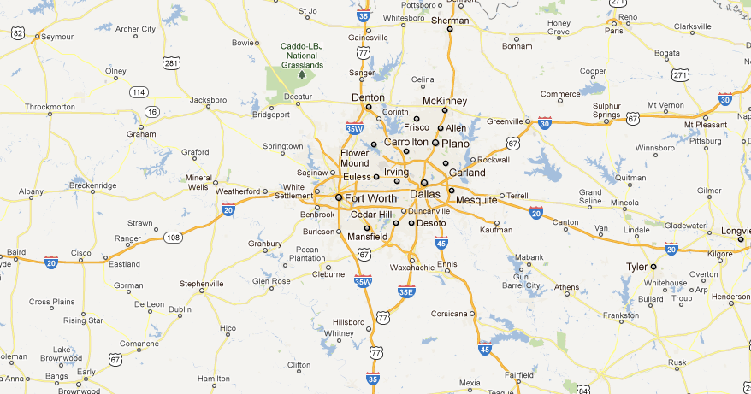
Two-Way Selection
Real Life Example
I35W takes you to Fort Worth.
I35E takes you to Dallas.
Interstate 35 splits into I35W and I35E just North of Hillsboro.

Slide 23
JAVA0503.JAVA
Enter your SAT score. --> 1200
You are admitted
// Java0503.java
// This program demonstrates two-way selection with <if..else>.
import java.util.Scanner;
public class Java0503
{
public static void main (String args[])
{
System.out.println("\nJAVA0503.JAVA\n");
Scanner input = new Scanner(System.in);
System.out.print("Enter your SAT score. --> ");
int sat = input.nextInt();
System.out.println();
if (sat >= 1100)
System.out.println("You are admitted");
else
System.out.println("You are not admitted");
}
}
JAVA0503.JAVA
Enter your SAT score. --> 1000
You are not admitted

Slide 24
JAVA0504.JAVA
Enter your SAT score. --> 1100
Your SAT score of 1100
meets our expectations.
You are admitted
// Java0504.java
// This program demonstrates two-way selection with curly braces block-structure.
import java.util.Scanner;
public class Java0504
{
public static void main (String args[])
{
System.out.println("\nJAVA0504.JAVA\n");
Scanner input = new Scanner(System.in);
System.out.print("Enter your SAT score. --> ");
int sat = input.nextInt();
System.out.println();
if (sat >= 1100)
{
System.out.println("Your SAT score of " + sat);
System.out.println("meets our expectations.");
System.out.println("You are admitted");
}
else
{
System.out.println("Your SAT score of " + sat);
System.out.println("does not meet our expectations.");
System.out.println("You are not admitted");
}
}
}
JAVA0504.JAVA
Enter your SAT score. --> 1099
Your SAT score of 1099
does not meet our expectations.
You are not admitted

Slide 25

Two-Way Selection
General Syntax:
if (condition true)
execute first program statement
else // when condition is false
execute second program statement
Specific Example:
if (gpa >= 90.0)
System.out.println ("You’re an honor graduate");
else
System.out.println ("You’re not an honor graduate");

Slide 26

Section 5.6
Multi Way
Selection

Slide 27

Multi-Way Selection
Real Life Example

Slide 28
// Java0505.java
// This program demonstrates multi-way selection with <switch> and <case>.
// This program compiles, but displays illogical output.
import java.util.Scanner;
public class Java0505
{
public static void main (String args[])
{
System.out.println("\nJAVA0505.JAVA\n");
Scanner input = new Scanner(System.in);
System.out.print("Enter month number. [1..12] --> ");
int month = input.nextInt();
System.out.println();
switch (month)
{
case 1 : System.out.println("January");
case 2 : System.out.println("February");
case 3 : System.out.println("March");
case 4 : System.out.println("April");
case 5 : System.out.println("May");
case 6 : System.out.println("June");
case 7 : System.out.println("July");
case 8 : System.out.println("August");
case 9 : System.out.println("September");
case 10 : System.out.println("October");
case 11 : System.out.println("November");
case 12 : System.out.println("December");
}
}
}

Slide 29
JAVA0505.JAVA
Enter month number. [1..12] --> 1
January
February
March
April
May
June
July
August
September
October
November
December
JAVA0505.JAVA
Enter month number. [1..12] --> 6
June
July
August
September
October
November
December
JAVA0505.JAVA
Enter month number. [1..12] --> 12
December

Slide 30
// Java0506.java
// This program demonstrates multi-way selection with <switch> and <case>.
// This program adds <break> and <default>. The use of <break> is required for logical output.
import java.util.Scanner;
public class Java0506
{
public static void main (String args[])
{
System.out.println("\nJAVA0506.JAVA\n");
Scanner input = new Scanner(System.in);
System.out.print("Enter month number. [1..12] --> ");
int month = input.nextInt();
System.out.println();
switch (month)
{
case 1 : System.out.println("January"); break;
case 2 : System.out.println("February"); break;
case 3 : System.out.println("March"); break;
case 4 : System.out.println("April"); break;
case 5 : System.out.println("May"); break;
case 6 : System.out.println("June"); break;
case 7 : System.out.println("July"); break;
case 8 : System.out.println("August"); break;
case 9 : System.out.println("September"); break;
case 10 : System.out.println("October"); break;
case 11 : System.out.println("November"); break;
case 12 : System.out.println("December"); break;
default : System.out.println("This is not a valid month number.");
}
System.out.println();
}
}

Slide 31
JAVA0506.JAVA
Enter month number. [1..12] --> 1
January
JAVA0506.JAVA
Enter month number. [1..12] --> 6
June
JAVA0506.JAVA
Enter month number. [1..12] --> 12
December
JAVA0506.JAVA
Enter month number. [1..12] --> 13
This is not a valid month number.

Slide 32
Multiple-Way Selection
General Syntax
switch(selectionVariable)
{
case selectionConstant :
program statement;
program statement;
: : :
break;
case selectionConstant :
program statement;
program statement;
: : :
break;
default
program statement;
program statement;
: : :
}

Slide 33
Multiple-Way Selection
Specific Example
switch(courseGrade)
{
case 'A' : points = 4; break;
case 'B' : points = 3; break;
case 'C' : points = 2; break;
case 'D' : points = 1; break;
case 'F' : points = 0; break;
default : System.out.println("Error");
}
The default statement is used to handle the situation when a proper match is not found. Frequently an error message is used to indicate that no match was found.

Slide 34

Section 5.7
Fixed
Repetition

Slide 35
// Java0507.java
// This program displays 60 identical lines efficiently
// with one println statement and a loop structure.
public class Java0507
{
public static void main(String args[])
{
System.out.println("\nJAVA0507.JAVA\n");
int k;
for (k = 1; k <= 60; k++)
System.out.println("Eat at Joe's friendly diner for the best lunch value");
}
}
JAVA0507.JAVA
Eat at Joe's friendly diner for the best lunch value
Eat at Joe's friendly diner for the best lunch value
Eat at Joe's friendly diner for the best lunch value
Eat at Joe's friendly diner for the best lunch value
Eat at Joe's friendly diner for the best lunch value
Eat at Joe's friendly diner for the best lunch value
Eat at Joe's friendly diner for the best lunch value
Eat at Joe's friendly diner for the best lunch value
Eat at Joe's friendly diner for the best lunch value
Eat at Joe's friendly diner for the best lunch value
Eat at Joe's friendly diner for the best lunch value
Eat at Joe's friendly diner for the best lunch value
Eat at Joe's friendly diner for the best lunch value
Eat at Joe's friendly diner for the best lunch value
Eat at Joe's friendly diner for the best lunch value
Eat at Joe's friendly diner for the best lunch value
Eat at Joe's friendly diner for the best lunch value
Eat at Joe's friendly diner for the best lunch value
Eat at Joe's friendly diner for the best lunch value
Eat at Joe's friendly diner for the best lunch value
Eat at Joe's friendly diner for the best lunch value
Eat at Joe's friendly diner for the best lunch value
Eat at Joe's friendly diner for the best lunch value
Eat at Joe's friendly diner for the best lunch value
: : : :
Continues 36 more times…

Slide 36
// Java0507.java
// This program displays 60 identical lines efficiently
// with one println statement and a loop structure.
public class Java0507
{
public static void main(String args[])
{
System.out.println("\nJAVA0507.JAVA\n");
int k;
for (k = 1; k <= 60; k++)
System.out.println("Eat at Joe's friendly diner for the best lunch value");
}
}
Another look
at the 3 parts
of a for loop
Part 1 is used to initialize the counter
(Loop Control Variable).

Slide 37
// Java0507.java
// This program displays 60 identical lines efficiently
// with one println statement and a loop structure.
public class Java0507
{
public static void main(String args[])
{
System.out.println("\nJAVA0507.JAVA\n");
int k;
for (k = 1; k <= 60; k++)
System.out.println("Eat at Joe's friendly diner for the best lunch value");
}
}
Another look
at the 3 parts
of a for loop
Part 1 is used to initialize the counter
(Loop Control Variable).
Part 2 is a condition. As long as it is true the loop will keep repeating.

Slide 38
// Java0507.java
// This program displays 60 identical lines efficiently
// with one println statement and a loop structure.
public class Java0507
{
public static void main(String args[])
{
System.out.println("\nJAVA0507.JAVA\n");
int k;
for (k = 1; k <= 60; k++)
System.out.println("Eat at Joe's friendly diner for the best lunch value");
}
}
Another look
at the 3 parts
of a for loop
Part 1 is used to initialize the counter
(Loop Control Variable).
Part 2 is a condition. As long as it is true the loop will keep repeating.
Part 3 indicates what the counter counts by. ++ means count by 1.

Slide 39
// Java0508.java
// This program displays consecutive numbers 1 through 15.
// It also shows how the loop control variable may be
// defined inside the <for> program statement.
public class Java0508
{
public static void main(String args[])
{
System.out.println("\nJAVA0508.JAVA\n");
for (int k = 1; k <= 15; k++)
System.out.print(k + " ");
System.out.println();
}
}
JAVA0508.JAVA
1 2 3 4 5 6 7 8 9 10 11 12 13 14 15

Slide 40
Defining the Loop Control Variable
Before the loop heading (not used much)
Inside the loop heading (preferred approach)
int k;
for (k = 1; k <= 10; k++)
{
System.out.println("Hello World");
}
for (int k = 1; k <= 10; k++)
{
System.out.println("Hello World");
}

Slide 41
// Java0509.java
// This program demonstrates how to use block structure
// with a <for> loop control structure.
public class Java0509
{
public static void main(String args[])
{
System.out.println("\nJAVA0509.JAVA\n");
for (int k = 1; k <= 5; k++)
{
System.out.println("##########################");
System.out.println("Line Number " + k);
}
System.out.println();
}
}
JAVA0509.JAVA
####################
Line Number 1
####################
Line Number 2
####################
Line Number 3
####################
Line Number 4
####################
Line Number 5

Slide 42
// Java0519.java
// This program displays various counting schemes.
// It also demonstrates the versatility of the <for> loop.
public class Java0519
{
public static void main(String args[])
{
System.out.println("\nJAVA0519.JAVA\n");
for (int p = 1; p <= 15; p++)
System.out.print(p + " ");
System.out.println("\n");
for (int q = 1; q <= 15; q+=3)
System.out.print(q + " ");
System.out.println("\n");
for (int r = 15; r >= 1; r--)
System.out.print(r + " ");
System.out.println("\n");
for (double s = 0; s <= 3; s+=0.5)
System.out.print(s + " ");
System.out.println("\n");
for (char t = 'A'; t <= 'Z'; t++)
System.out.print(t + " ");
System.out.println("\n\n");
}
}
JAVA0510.JAVA
1 2 3 4 5 6 7 8 9 10 11 12 13 14 15
1 4 7 10 13
15 14 13 12 11 10 9 8 7 6 5 4 3 2 1
0.0 0.5 1.0 1.5 2.0 2.5 3.0
A B C D E F G H I J K L M N O P Q R S T U V W X Y Z
You do NOT always have to use ++ in the 3rd part of a for loop.
You can count by any amount.
You can count backwards.
You can count by fractional amounts.
You can even count with characters.

Slide 43

Fixed Repetition
Java has a variety of control structures for repetition.
Other computer science terms for repetition are looping and iteration.
Fixed Repetition is done with the for loop structure.
General Syntax:
The for loop has three distinct parts:
Part1 initializes the Loop Control Variable.
Part2 sets the exit condition for the loop.
Part3 determines how the LCV changes.
Specific Example:
for (Part1; Part2; Part3)
loop body;
for (k = 1; k <= 10; k++)
System.out.println("Java is 10 times more fun");

Slide 44

Section 5.8
Conditional
Repetition

Slide 45


Conditional Repetition
Real Life Examples

Slide 46
Note to Students with Advanced Knowledge
It is possible to treat the for loop structure like a conditional loop that is not fixed. In fact, a for loop can be designed to behave exactly like a while loop.
It is my intention to use and treat a for loop like a fixed iteration loop and use the while loop and do...while loop for other repetition situations.
This approach is less likely to cause confusion. At some later date, when you are comfortable with all the control structures, you can use them in any appropriate manner.
If this does not make sense to you, do not worry.
Ignore this little summary box, and move on.

Slide 47
// Java0511.java
// This program demonstrates the precondition <while> loop.
// This loop will continue until the loop condition is false.
public class Java0511
{
public static void main(String args[])
{
System.out.println("\nJAVA0511.JAVA\n");
int number = 0;
while (number <= 10)
{
System.out.println("Number: " + number);
number++;
}
}
}
JAVA0511.JAVA
Number: 0
Number: 1
Number: 2
Number: 3
Number: 4
Number: 5
Number: 6
Number: 7
Number: 8
Number: 9
Number: 10

Slide 48
Pre-Conditional Repetition
General Syntax:
initialize condition variable before the while loop
while(condition is true)
{
loop body
alter condition variable in the loop body
}
Specific Example:
int pin = 0; // initialize condition variable
while(pin != 5678)
{
System.out.print("Enter pin. ===>> ");
pin = input.nextInt(); // alter condition variable
}
System.out.println("Welcome.");

Slide 49
Program Segment NoNo #1 | Program Segment YesYes #1
int x = 0; while(x < 10) System.out.println(x); | int x = 0; while(x < 10) { x++; System.out.println(x); }
The loop condition variable, x, never changes. The loop will not exit. | The loop condition variable, x, changes. The loop exits when x reaches 10.

Slide 50
Program Segment NoNo #2 | Program Segment YesYes #2
int x; while(x < 10) { x++; System.out.println(x); } | int x = 0; while(x < 10) { x++; System.out.println(x); }
The loop condition variable, x, is never initialized. This program will not compile in Java. | The loop condition variable, x, is initialized. The program will compile and execute normally.

Slide 51
// Java0512.java
// This program demonstrates the postcondition <do..while> loop. This loop structure guarantees at
// least one repetition of the loop body. Like the <while> loop this is not a "fixed iteration" loop.
import java.util.Scanner;
public class Java0512
{
public static void main(String args[])
{
System.out.println("\nJAVA0512.JAVA\n");
Scanner input = new Scanner(System.in);
System.out.println("Please enter your ATM Personal Identification Number (PIN)!");
System.out.println();
int pin = 0;
do
{
System.out.print("Enter your PIN ==>> ");
PIN = input.nextInt();
System.out.println();
if (pin != 1234)
System.out.println("That is not the correct PIN.");
System.out.println();
}
while (pin != 1234);
System.out.println("Your PIN is correct; you may proceed.");
}
}

Slide 52
Java0512.java Output
Please enter your ATM Personal Identification Number (PIN)!
Enter your PIN ==>> 1111
That is not the correct PIN.
Enter your PIN ==>> 6623
That is not the correct PIN.
Enter your PIN ==>> 9876
That is not the correct PIN.
Enter your PIN ==>> 1234
Your PIN is correct; you may proceed.

Slide 53
Post-Conditional Repetition
General Syntax:
initialize condition variable before the do..while loop
do
{
loop body
alter condition variable in the loop body
}
while(condition is true)
Specific Example:
int pin = 0; // initialize condition variable
do
{
System.out.print("Enter pin. ===>> ");
pin = input.nextInt(); // alter condition variable
}
while(pin != 5678); // Not a heading, Semicolon is required.
System.out.println("Welcome.");

Slide 54
Fixed Repetition vs. Conditional Repetition
Fixed Repetition describes a situation where you know – ahead of time – how many times you want the loop to repeat.
An example would be drawing exactly 100 circles on the screen.
The command for fixed repetition is for.
Conditional Repetition describes a situation where you do NOT know how many times the loop will repeat.
The loop has to repeat until some condition is met.
An example would be entering a password.
The command for pre-conditional repetition is while.
The commands for post-conditional repetition is do..while.

Slide 55

AP® Exam Alert
Selection Control Structures
The one-way selection if is tested on the AP® Exam.
if (sales >= 500000)
bonus = bonus + 5000.0;
The two-way selection if..else is tested on the AP® Exam.
if (sat >= 1200)
System.out.println("You're admitted");
else
System.out.println("You're not admitted");
The multi-way selection switch..case..break is NOT tested on the AP® Exam.
switch (grade)
{
case 'A' : gpaPoints = 4; break;
case 'B' : gpaPoints = 3; break;
case 'C' : gpaPoints = 2; break;
case 'D' : gpaPoints = 1; break;
case 'F' : gpaPoints = 0;
}

Slide 56
AP® Exam Alert
Repetition Control Structures
The fixed-repetition for loop is tested on the AP® Exam.
for (int k = 1; k <= max; k++)
sum += k;
The pre-condition while loop is tested on the AP® Exam.
while (k < max)
{
sum += k; k++;
}
The post-condition do..while loop is NOT tested on the AP® Exam.
do
{
sum += k;
k++;
}
while (k < max);

Slide 57
Section 5.9
Control Structures
with Graphics

Slide 58
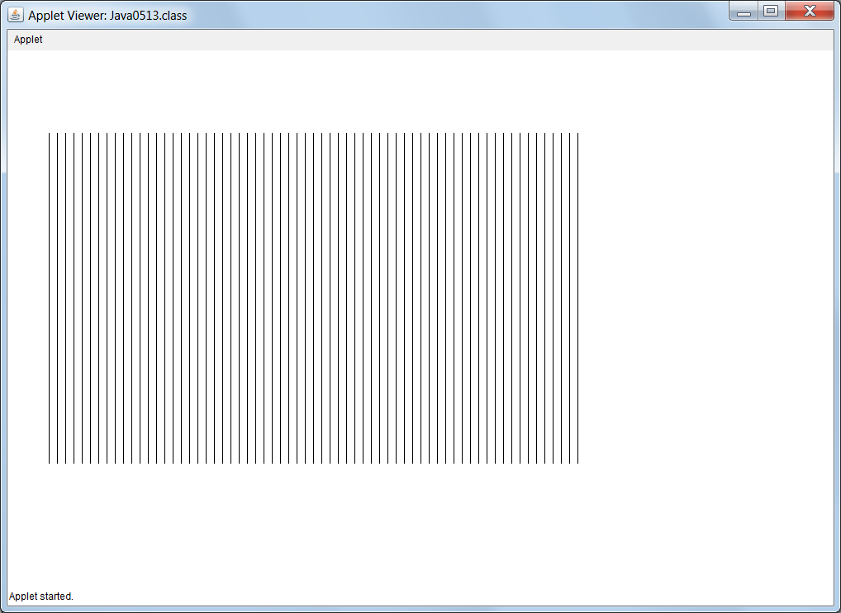
// Java0513.java
// This program shows how a control structure can be used with graphics.
// This program draws vertical lines, because x1 and x2 have the same value.
import java.awt.*;
import java.applet.*;
public class Java0513 extends Applet
{
public void paint(Graphics g)
{
int y1 = 100;
int y2 = 500;
for (int x = 50; x < 700; x +=10)
g.drawLine(x,y1,x,y2);
}
}

Slide 59
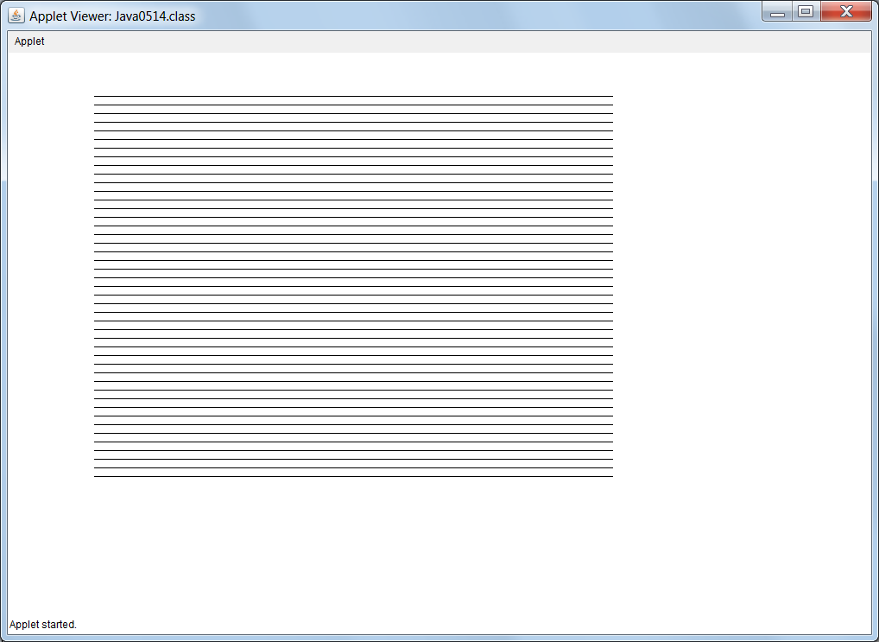
// Java0514.java
// This program shows how a control structure can be used with graphics.
// This program draws horizontal lines, because y1 and y2 have the same value.
import java.awt.*;
import java.applet.*;
public class Java0514 extends Applet
{
public void paint(Graphics g)
{
int x1 = 100;
int x2 = 700;
for (int y = 50; y < 500; y +=10)
g.drawLine(x1,y,x2,y);
}
}

Slide 60
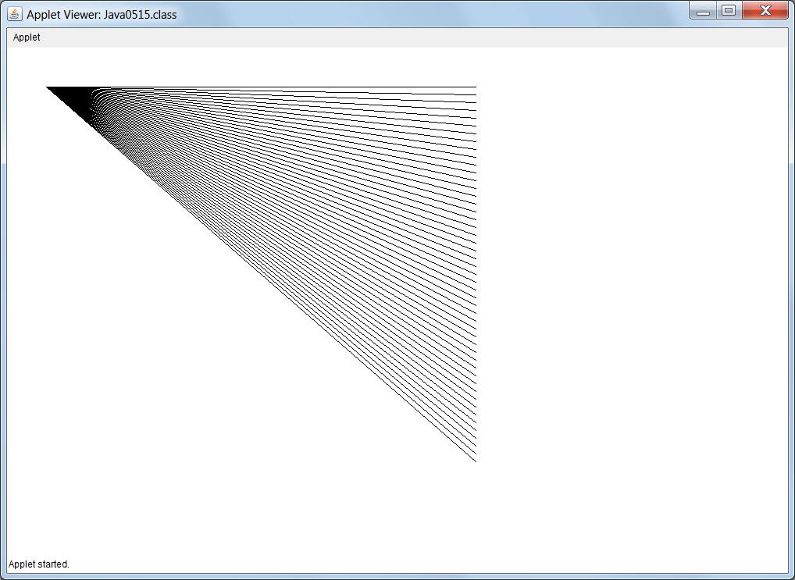
// Java0515.java
// This program demonstrates how to rotate a line around a point.
// In this case the (x1,y1) coordinate stays fixed and the (x2,y2) point changes.
import java.awt.*;
import java.applet.*;
public class Java0515 extends Applet
{
public void paint(Graphics g)
{
int x1 = 50;
int y1 = 50;
int x2 = 600;
int y2 = 50;
for (int k = 1; k < 50; k++)
{
g.drawLine(x1,y1,x2,y2);
y2 += 10;
}
}
}

Slide 61
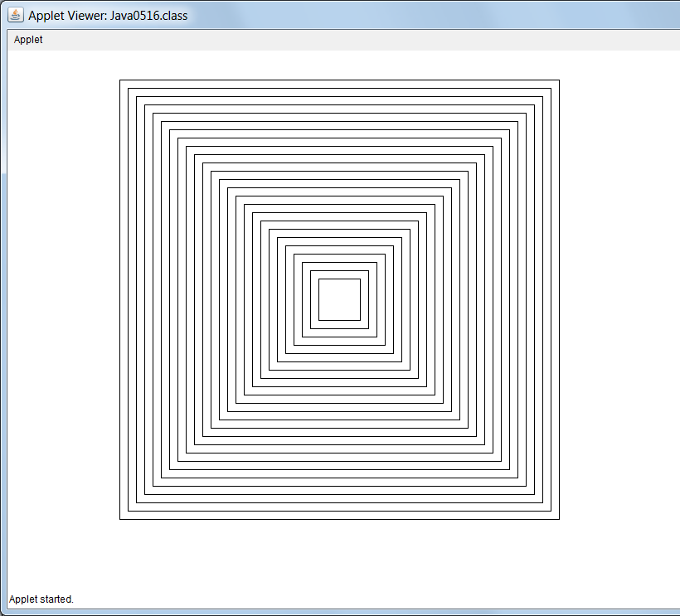
// Java0516.java
// This program is example of displaying multiple graphics rectangles
// using a loop control structure.
import java.awt.*;
import java.applet.*;
public class Java0516 extends Applet
{
public void paint(Graphics g)
{
int x = 375;
int y = 275;
int side = 50;
for (int k = 1; k <= 25; k++)
{
g.drawRect(x,y,side,side);
x -= 10;
y -= 10;
side += 20;
}
}
}

Slide 62
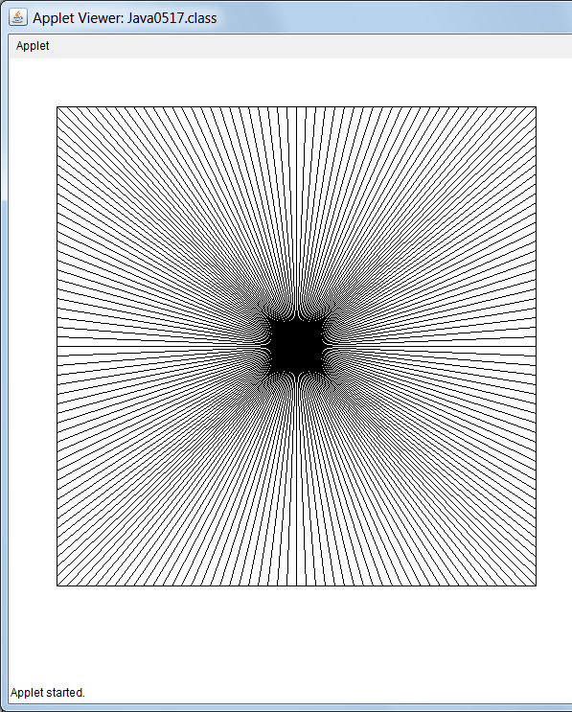
// Java0517.java
// This program create an interesting pattern.
import java.awt.*;
import java.applet.*;
public class Java0517 extends Applet
{
public void paint(Graphics g)
{
g.drawRect(50,50,500,500);
for (int x = 50; x <= 550; x += 10)
g.drawLine(x,50,600-x,550);
for (int y = 50; y <= 550; y += 10)
g.drawLine(50,y,550,600-y);
}
}

Slide 63
Section 5.10
Nested
Control Structures

Slide 64

// Java0518.java
// This program demonstrates nesting an <if..else> structure inside another <if..else> structure.
// This will determine if a student is eligible for financial aid.
// Note that this is not an issue for students whose SAT scores are below 1100.
import java.util.Scanner;
public class Java0518
{
public static void main (String args[])
{
System.out.println("JAVA0518.JAVA\n");
Scanner input = new Scanner(System.in);
System.out.print("Enter SAT ===>> ");
int sat = input.nextInt();
System.out.println();
if (sat >= 1100)
{
System.out.println("You are admitted");
System.out.println("Orientation will start in June");
System.out.println();
System.out.print("What is your family income? ===>> ");
int income = input.nextInt();
System.out.println();
if (income <= 20000)
System.out.println("You qualify for financial aid.");
else
System.out.println("You do not qualify for financial aid.");
}
else
{
System.out.println("You are not admitted");
System.out.println("Please try again when your SAT improves.");
}
System.out.println();
}
}

Slide 65
JAVA0518.JAVA
Enter SAT ===>> 1350
You are admitted
Orientation will start in June
What is your family income? ===>> 18000
You qualify for financial aid.
JAVA0518.JAVA
Enter SAT ===>> 1500
You are admitted
Orientation will start in June
What is your family income? ===>> 90000
You do not qualify for financial aid.
JAVA0518.JAVA
Enter SAT ===>> 700
You are not admitted
Please try again when your SAT improves.

Slide 66
// Java0519.java
// This program determine your graduation status based on your college GPA using multiple nested
// <if..else> statements. This is necessary because <switch> only works with integers, characters & strings.
import java.util.Scanner;
public class Java0519
{
public static void main (String args[])
{
System.out.println("JAVA0519.JAVA\n");
Scanner input = new Scanner(System.in);
System.out.print("Enter GPA ===>> ");
double gpa = input.nextDouble();
System.out.println();
if (gpa >= 3.9)
System.out.println("Summa Cum Laude");
else if (gpa >= 3.75)
System.out.println("Magna Cum Laude");
else if (gpa >= 3.5)
System.out.println("Cum Laude");
else if (gpa >= 2.0)
System.out.println("Graduate without honors");
else
System.out.println("Will not graduate");
System.out.println();
}
}
JAVA0519.JAVA
Enter GPA ===>> 4.0
Summa Cum Laude
JAVA0519.JAVA
Enter GPA ===>> 3.88
Magna Cum Laude
JAVA0519.JAVA
Enter GPA ===>> 3.63
Cum Laude
Is this really multi-way selection?
JAVA0519.JAVA
Enter GPA ===>> 2.65
Graduate without honors
JAVA0519.JAVA
Enter GPA ===>> 1.99
Will not graduate

Slide 67
// Java520.java
// This program displays several multiplication tables using
// a nested <for> loop structure.
public class Java1520
{
public static void main(String args[])
{
System.out.println("Java0520\n");
for (int table = 11; table <= 13; table++)
{
for (int k = 1; k <= 5; k++)
{
System.out.println(k + " * "
+ table + " = " + k * table);
}
System.out.println();
}
}
}
JAVA0520.JAVA
1 * 11 = 11
2 * 11 = 22
3 * 11 = 33
4 * 11 = 44
5 * 11 = 55
1 * 12 = 12
2 * 12 = 24
3 * 12 = 36
4 * 12 = 48
5 * 12 = 60
1 * 13 = 13
2 * 13 = 26
3 * 13 = 39
4 * 13 = 52
5 * 13 = 65

Slide 68
// Java0521.java
// This program displays several multiplication tables using
// nested pre-condition <while> loop structures.
public class Java0521
{
public static void main(String args[])
{
System.out.println("Java0521\n");
int k = 1;
int table = 11;
while (table <= 13)
{
while (k <= 5)
{
System.out.println(k + " * "
+ table + " = " + k * table);
k++;
}
System.out.println();
k = 1;
table++;
}
}
}
JAVA0521.JAVA
1 * 11 = 11
2 * 11 = 22
3 * 11 = 33
4 * 11 = 44
5 * 11 = 55
1 * 12 = 12
2 * 12 = 24
3 * 12 = 36
4 * 12 = 48
5 * 12 = 60
1 * 13 = 13
2 * 13 = 26
3 * 13 = 39
4 * 13 = 52
5 * 13 = 65

Slide 69
Section 5.11
Boolean
Operators

Slide 70
AP® Exam Alert
The AP®CS Examination includes a variety of Boolean Logic questions.
Many questions require indirect knowledge of Boolean Logic, and other questions are directly focused on testing a student’s understanding of Boolean concepts.
Test results have shown that many students score quite poorly on this part of the AP®CS Examination.
Statistical Analysis of these test results have also shown that the students who perform poorly on Boolean Logic questions, perform poorly on the AP® Exam as a whole; and the students who perform well on the Boolean Logic questions, perform well on the AP® Exam as a whole.

Slide 71

Logical OR Example
Consider two young ladies who have a rather simplistic, and quite politically incorrect, view of judging potential dates. The first is Kathy who will date a guy if he is Good Looking OR drives a Nice Car. This chart shows her 4 possible cases:
Good Looking? | Nice Car? | Date Material?

Slide 72
Boolean Operators
Boolean OR
A
T
T
F
F
B
T
F
T
F
A or B
T
T
T
F

Slide 73

Logical AND Example
Suzy is more picky than Kathy. Suzy will only date a guy if he BOTH Good Looking AND drives a Nice Car. This chart shows her 4 possible cases:
Good Looking? | Nice Car? | Date Material?

Slide 74
Boolean Operators
Boolean AND
A
T
T
F
F
B
T
F
T
F
A and B
T
F
F
F

Slide 75
Boolean Operators
Boolean XOR
A
T
T
F
F
B
T
F
T
F
A xor B
F
T
T
F

Slide 76
Boolean Operators
Boolean NOT
A
T
F
~A
F
T

Slide 77
Boolean Operators
Boolean NOT Continued
A
T
T
F
F
B
T
F
T
F
~A
F
F
T
T
~B
F
T
F
T

Slide 78
Section 5.12
Truth
Tables

Slide 79
Truth Table #1
A and (A or B)
A
T
T
F
F
B
T
F
T
F
A or B
T
T
T
F
A and (A or B)
T
T
F
F

Slide 80
Truth Table #2
(A and B) or C
A
T
T
T
T
F
F
F
F
B
T
T
F
F
T
T
F
F
C
T
F
T
F
T
F
T
F
A and B
T
T
F
F
F
F
F
F
(A and B) or C
T
T
T
F
T
F
T
F

Slide 81
Truth Table #3
(A or B) and C
A
T
T
T
T
F
F
F
F
B
T
T
F
F
T
T
F
F
C
T
F
T
F
T
F
T
F
A or B
T
T
T
T
T
T
F
F
(A or B) and C
T
F
T
F
T
F
F
F

Slide 82
Truth Table Fact
The truth tables of equivalent Boolean expressions are identical.

Slide 83
Truth Table #4
Is ~(A or B) = ~A or ~B ?
A
T
T
F
F
B
T
F
T
F
A or B
T
T
T
F
~(A or B)
F
F
F
T
~A
F
F
T
T
~B
F
T
F
T
~A or ~B
F
T
T
T
^ NO ^

Slide 84
Truth Table #5
Is ~(A or B) = ~A and ~B ?
A
T
T
F
F
B
T
F
T
F
A or B
T
T
T
F
~(A or B)
F
F
F
T
~A
F
F
T
T
~B
F
T
F
T
~A and ~B
F
F
F
T
^ YES ^

Slide 85
Truth Table #6
Is ~(A and B) = ~A or ~B ?
A
T
T
F
F
B
T
F
T
F
A and B
T
F
F
F
~(A and B)
F
T
T
T
~A
F
F
T
T
~B
F
T
F
T
~A or ~B
F
T
T
T
^ YES ^

Slide 86
DeMorgan’s Law
not(A and B) = not A or not B
not(A or B) = not A and not B
This says the same thing:
~(A + B) = ~A * ~B
~(A * B) = ~A + ~B

Slide 87
Section 5.13
Compound
Conditions

Slide 88
// Java0522.java
// This program demonstrates compound decisions with the logical or ( || ) operator.
import java.util.Scanner;
public class Java0522
{
public static void main (String args[])
{
System.out.println("Java0522\n");
Scanner input = new Scanner(System.in);
int education; // years of education
int experience; // years of work experience
System.out.print("Enter years of education ===>> ");
education = input.nextInt();
System.out.print("Enter years of experience ===>> ");
experience = input.nextInt();
if ( education >= 16 || experience >= 5 )
System.out.println("You are hired");
else
System.out.println("You are not qualified");
}
}

Slide 89
JAVA0522.JAVA
Enter # of years of Education. ===>> 16
Enter # of years of Work Experience. ===>> 0
You are hired
JAVA0522.JAVA
Enter # of years of Education. ===>> 13
Enter # of years of Work Experience. ===>> 7
You are hired
OR
JAVA0522.JAVA
Enter # of years of Education. ===>> 18
Enter # of years of Work Experience. ===>> 10
You are hired
JAVA0522.JAVA
Enter # of years of Education. ===>> 12
Enter # of years of Work Experience. ===>> 3
You are not qualified

Slide 90
// Java0523.java
// This program demonstrates compound decisions with the logical and ( && ) operator.
import java.util.Scanner;
public class Java0523
{
public static void main (String args[])
{
System.out.println("Java0523\n");
Scanner input = new Scanner(System.in);
int education; // years of education
int experience; // years of work experience
System.out.print("Enter years of education ===>> ");
education = input.nextInt();
System.out.print("Enter years of experience ===>> ");
experience = input.nextInt();
if ( education >= 16 && experience >= 5 )
System.out.println("You are hired");
else
System.out.println("You are not qualified");
}
}

Slide 91
JAVA0523.JAVA
Enter # of years of Education. ===>> 16
Enter # of years of Work Experience. ===>> 0
You are not qualified
JAVA0523.JAVA
Enter # of years of Education. ===>> 13
Enter # of years of Work Experience. ===>> 7
You are not qualified
AND
JAVA0523.JAVA
Enter # of years of Education. ===>> 18
Enter # of years of Work Experience. ===>> 10
You are hired
JAVA0523.JAVA
Enter # of years of Education. ===>> 12
Enter # of years of Work Experience. ===>> 3
You are not qualified

Slide 92
Java Logical Operators
Java uses || to indicate a logical OR.
Java uses && to indicate a logical AND.
Java uses ! to indicate a logical NOT.
Java uses != for not equals, but != can
also be used to indicate a logical XOR.

Slide 93
Section 5.14
Program Input
Protection

Slide 94
// Java0524.java
// This program demonstrates program input protection with a compound condition.
// The <do...while> loop forces the user to re-enter when data is invalid.
import java.util.Scanner;
public class Java0524
{
public static void main (String args[])
{
System.out.println("JAVA0524.JAVA");
Scanner input = new Scanner(System.in);
char gender;
do
{
System.out.print("\nEnter Your Gender. ===>> ");
gender = input.nextLine().charAt(0);
System.out.println();
if (!(gender == 'M' || gender == 'F'))
{
System.out.println("Invalid Gender Entered: " + gender);
System.out.println("You must enter M or F.");
}
}
while (!(gender == 'M' || gender == 'F'));
if (gender == 'M')
System.out.println("Your gender is Male.");
else
System.out.println("Your gender is Female.");
System.out.println("You may proceed.");
}
}
JAVA0524.JAVA
Enter Your Gender. ===>> Q
Invalid Gender Entered: Q
You must enter M or F
Enter Your Gender. ===>> 3
Invalid Gender Entered: 3
You must enter M or F
Enter Your Gender. ===>> M
Your gender is Male.
You may proceed

Slide 95
// Java0525.java
// This program uses a <boolean> variable to make the program more readable.
import java.util.Scanner;
public class Java0525
{
public static void main (String args[])
{
System.out.println("JAVA0525.JAVA");
Scanner input = new Scanner(System.in);
char gender;
boolean genderInvalid;
do
{
System.out.print("\nEnter Your Gender. ===>> ");
gender = input.nextLine().charAt(0);
System.out.println();
genderInvalid = !(gender == 'M' || gender == 'F');
if (genderInvalid)
{
System.out.println("Invalid Gender Entered: " + gender);
System.out.println("You must enter M or F.");
}
}
while (genderInvalid);
if (gender == 'M')
System.out.println("Your gender is Male.");
else
System.out.println("Your gender is Female.");
System.out.println("You may proceed.");
}
}

Slide 96
// Java0526.java
// This program attempts to "distribute the not" through the compound condition.
// The program does not function properly because DeMorgan’s Law was not considered.
import java.util.Scanner;
public class Java0526
{
public static void main (String args[])
{
System.out.println("JAVA0526.JAVA");
Scanner input = new Scanner(System.in);
char gender;
boolean genderInvalid;
do
{
System.out.print("\nEnter Your Gender. ===>> ");
gender = input.nextLine().charAt(0);
System.out.println();
genderInvalid = gender != 'M' || gender != 'F';
if (genderInvalid)
{
System.out.println("Invalid Gender Entered: " + gender);
System.out.println("You must enter M or F");
}
}
while (genderInvalid);
if (gender == 'M')
System.out.println("Your gender is Male.");
else
System.out.println("Your gender is Female.");
System.out.println("You may proceed");
}
}
JAVA0526.JAVA
Enter Your Gender. ===>> Q
Invalid Gender Entered: Q
You must enter M or F
Enter Your Gender. ===>> 3
Invalid Gender Entered: 3
You must enter M or F
Enter Your Gender. ===>> F
Invalid Gender Entered: F
You must enter M or F
Enter Your Gender. ===>> F
Invalid Gender Entered: F
You must enter M or F
Enter Your Gender. ===>> M
Invalid Gender Entered: M
You must enter M or F
Enter Your Gender. ===>> M
Invalid Gender Entered: M
You must enter M or F
: : :
The program never stops !!!!

Slide 97
DeMorgan’s Law Again
not(A and B) = not A or not B
not(A or B) = not A and not B
Still the same thing as…
~(A + B) = ~A * ~B
~(A * B) = ~A + ~B

Slide 98
// Java0527.java
// This program fixes the error of the previous program by properly using DeMorgan's Law.
import java.util.Scanner;
public class Java0527
{
public static void main (String args[])
{
System.out.println("JAVA0527.JAVA");
Scanner input = new Scanner(System.in);
char gender;
boolean genderInvalid;
do
{
System.out.print("\nEnter Your Gender. ===>> ");
gender = input.nextLine().charAt(0);
System.out.println();
genderInvalid = gender != 'M' && gender != 'F';
if (genderInvalid)
{
System.out.println("Invalid Gender Entered: " + gender);
System.out.println("You must enter M or F");
}
}
while (genderInvalid);
if (gender == 'M')
System.out.println("Your gender is Male.");
else
System.out.println("Your gender is Female.");
System.out.println("You may proceed");
}
}
JAVA0527.JAVA
Enter Your Gender. ===>> Q
Invalid Gender Entered: Q
You must enter M or F
Enter Your Gender. ===>> 3
Invalid Gender Entered: 3
You must enter M or F
Enter Your Gender. ===>> F
Your gender is Female.
You may proceed

Slide 99

Section 5.15
Short
Circuiting

Slide 100
Short-Circuiting with and
A and ((A or B) and (B or C) and (A or C) or ((B and C) or (A and B)))
This statement is false whenever the first A is false.
In such a situation it is not necessary to check the remainder of the statement.

Slide 101
Short-Circuiting with or
A or ((A or B) and (B or C) and (A or C) or ((B and C) or (A and B)))
This statement is true whenever the first A is true.
In such a situation it is not necessary to check the remainder of the statement.

Slide 102
The isEven Method
Method isEven will be used in the next 2 programs.
Not only will this method tell you if an integer is even,
it will also display output so you know if the method was called.
public static boolean isEven(int number)
{
System.out.println();
System.out.println("Calling isEven Method");
System.out.println();
if (number % 2 == 0)
return true;
else
return false;
}

Slide 103
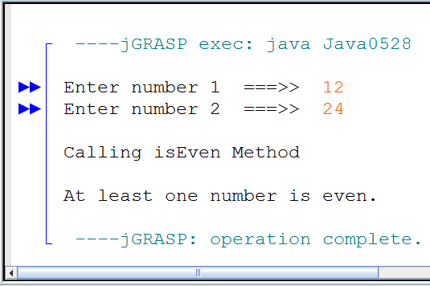
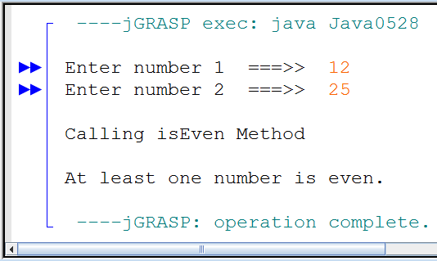
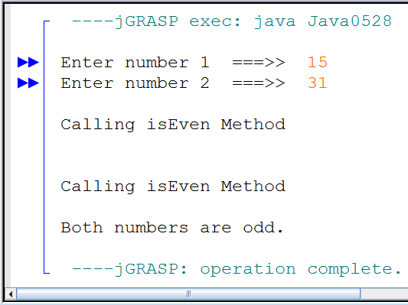
// Java0528.java
// This program uses "short circuiting" and uses the isEven
// method to demonstrate short circuiting with logical or.
public class Java0528
{
public static void main (String args[])
{
Scanner input = new Scanner(System.in);
System.out.print("Enter number 1 ===>> ");
int n1 = input.nextInt();
System.out.print("Enter number 2 ===>> ");
int n2 = input.nextInt();
if (isEven(n1) || isEven(n2))
System.out.println("At least one number is even.");
else
System.out.println("Both numbers are odd.");
}
public static boolean isEven(int number)
// shown already
}

Slide 104
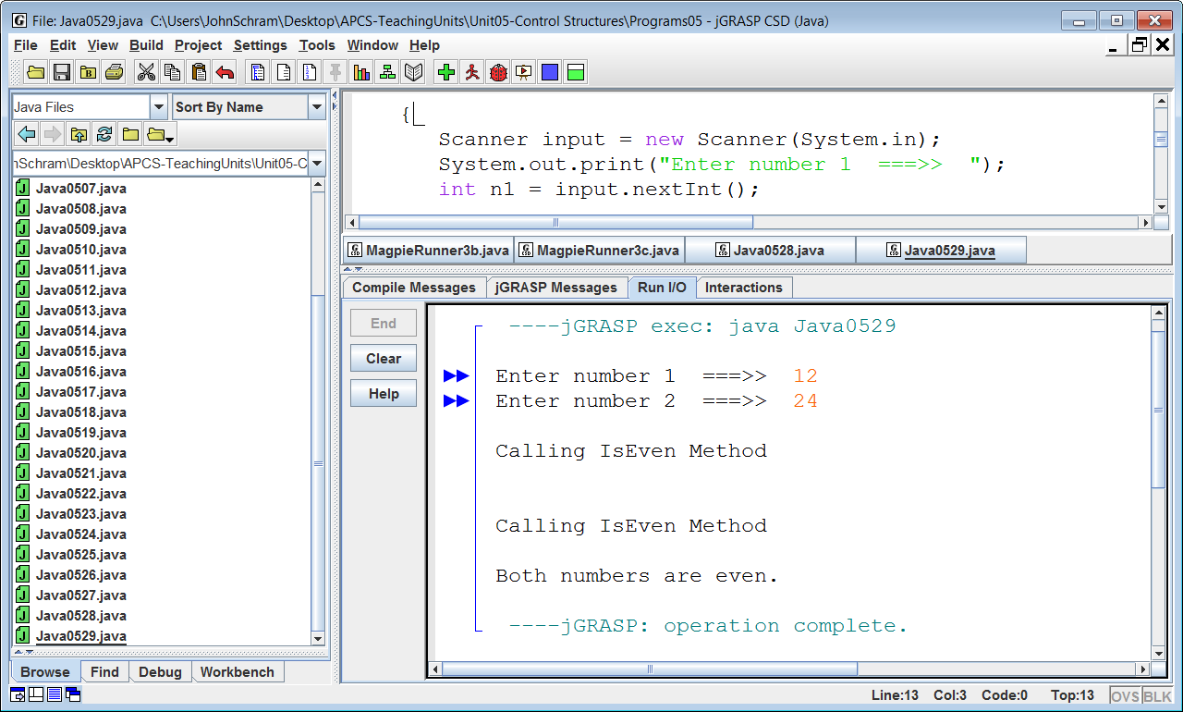

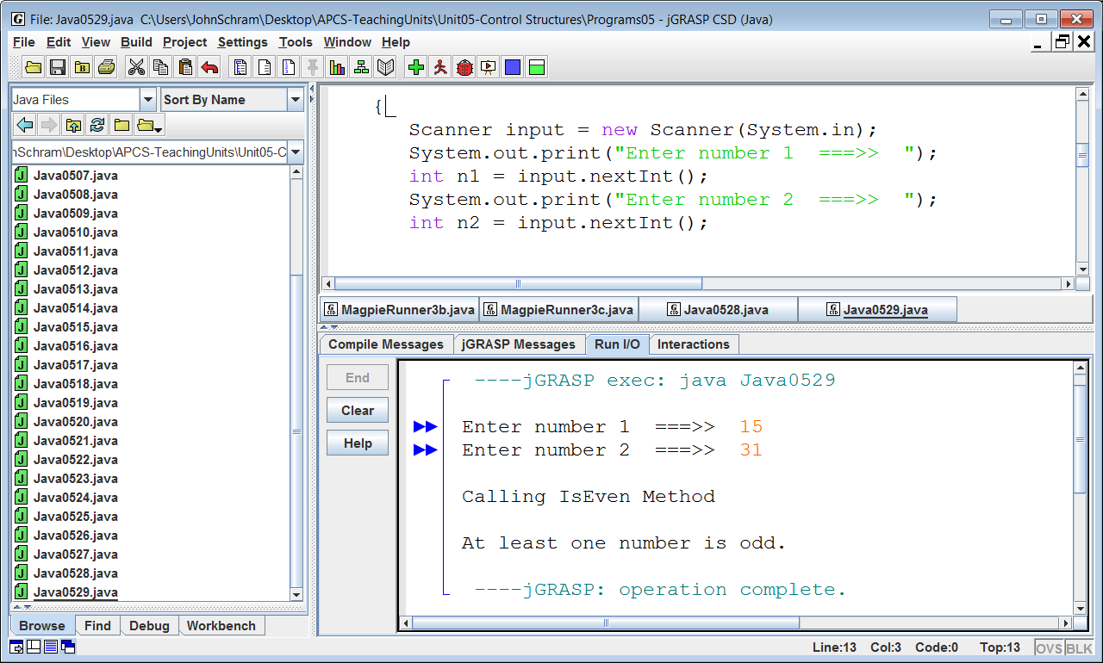
// Java0529.java
// This program uses "short circuiting" and uses the isEven
// method to demonstrate short circuiting with logical and.
public class Java0529
{
public static void main (String args[])
{
Scanner input = new Scanner(System.in);
System.out.print("Enter number 1 ===>> ");
int n1 = input.nextInt();
System.out.print("Enter number 2 ===>> ");
int n2 = input.nextInt();
if (isEven(n1) && isEven(n2))
System.out.println("Both numbers are even.");
else
System.out.println("At least one number is odd.");
}
public static boolean isEven(int number)
// shown already
}

